Slide 1
Divide and conquer
Fundamentals of Design and Analysis of Algorithms
Part-3

Slide 2
Contents
General Method
Binary Search
Merge Sort
Quick Sort
Exponential
Strassen’s Matrix Multiplication
Finding Minimum and Maximum

Slide 3
General Method
The given problem is
Divided into small sub problems
Sub problems are solved independently
Sub problems are of same type as the original problem (recursive algorithms are used)
Combine the solutions of sub problems in to a solution of the whole

Slide 4
Binary Search
This works on sorted array
An element which is to be searched from the list of elements stored in array A[0..n-1] is called KEY element.
Let A[m] be the mid element of the array A.
3 conditions
If KEY = A[m] the element is present
If KEY < A[m] then search left sub list
Else if KEY > A[m] then search the right sub list

Slide 5
Example
0 1 2 3 4 5 6
10 | 20 | 30 | 40 | 50 | 60 | 70
Low high
10 | 20 | 30 | 40 | 50 | 60 | 70
Left sub list mid right sub list
Element to be searched(KEY) is 60
Now the get the middle element: m = 3 [(low + High)/2]
Step 1:Check A[m] = KEY
Step 2: search right sub list

Slide 6

Binary search analysis

Slide 7
Analysis of Binary Search
Suppose we have an array A and in this array we are searching for a value K
If A has no special properties, then there is no better way to search K than linear search.
-- to start at the beginning and go through the array one step at a time, comparing each element to K in turn.
The time it takes (on average, and in the worst case) is linear, or O(N), to the number of items of array.
But if A is a sorted array, there is a much faster way, Binary Search, to look for K.

Slide 8
Analysis of Binary Search
In binary search, after each iteration, the length of the array we are looking in gets cut in half.
Binary Search can be analyzed with the best, worst, and average case number of comparisons.
These analyses are dependent upon the length of the array, so let N =|A| denote the length of the Array A.

Slide 9
Analysis of Binary Search
The numbers of comparisons for the recursive and iterative versions of Binary Search are the same
For Recursive Binary Search, count each pass through the if-then-else block as one comparison.
For Iterative Binary Search, count each pass through the while block as one comparison.

Slide 10
Binary search – Best case
Best case - O (1) comparisons
In the best case, the item X is the middle in the array A.
A constant number of comparisons (actually just 1) are required.

Slide 11
Binary search – worst case
Worst case - O (log n) comparisons
In the worst case, the item X does not exist in the array A at all.
Through each recursion or iteration of Binary Search, the size of the admissible range is halved.
This halving can be done ceiling(log n ) times. Thus, ceiling(log n ) comparisons are required.

Slide 12
Binary search – average case
Average case - O (log n) comparisons
To simplify the analysis, assume that no item which is not in A will be searched for, and that the probabilities of searching for each element are uniform.

Slide 13
Note
The difference between O(log(N)) and O(N) is extremely significant when N is large: for any practical problem it is crucial that we avoid O(N) searches

Slide 14
Binary search space complexity
The space requirements for the recursive and iterative versions of binary search are different.
Iterative Binary Search requires only a constant amount of space, while Recursive Binary Search requires space proportional to the number of comparisons to maintain the recursion stack.
Both iteration and recursion are based on a control structure: Iteration uses a repetition structure; recursion uses a selection structure.

Slide 15
Merge Sort
Apply divide-and-conquer to sorting problem
Problem: Given n elements, sort elements into non-decreasing order
Divide-and-Conquer:
If n=1 terminate (every one-element list is already sorted)
If n>1, partition elements into two or more sub-collections; sort each; combine into a single sorted list
How do we partition?

Slide 16
Partitioning - Choice 1
First n-1 elements into set A, last element set B
Sort A using this partitioning scheme recursively
B already sorted
Combine A and B using method Insert() (= insertion into sorted array)
Leads to recursive version of InsertionSort()
Number of comparisons: O(n²)
Best case = n-1
Worst case =

Slide 17
Partitioning - Choice 2
Put element with largest key in B, remaining elements in A
Sort A recursively
To combine sorted A and B, append B to sorted A
Use Max() to find largest element → recursive SelectionSort()
Use bubbling process to find and move largest element to right-most position → recursive BubbleSort()
All O(n²)

Slide 18
Partitioning - Choice 3
Let’s try to achieve balanced partitioning
A gets n/2 elements, B gets rest half
Sort A and B recursively
Combine sorted A and B using a process called merge, which combines two sorted lists into one
How? We will see soon

Slide 19
Example
Partition into lists of size n/2
[10, 4, 6, 3, 8, 2, 5, 7]
[10, 4, 6, 3]
[8, 2, 5, 7]
[10, 4]
[6, 3]
[8, 2]
[5, 7]
[4] [10]
[3][6]
[2][8]
[5][7]

Slide 20
Example Cont’d
Merge
[2, 3, 4, 5, 6, 7, 8, 10 ]
[3, 4, 6, 10]
[2, 5, 7, 8]
[4, 10]
[3, 6]
[2, 8]
[5, 7]
[4] [10]
[3][6]
[2][8]
[5][7]

Slide 21
Static Method mergeSort()
Public static void mergeSort(Comparable []a, int left, int right)
{
// sort a[left:right]
if (left < right)
{// at least two elements
int mid = (left+right)/2; //midpoint
mergeSort(a, left, mid);
mergeSort(a, mid + 1, right);
merge(a, b, left, mid, right); //merge from a to b
copy(b, a, left, right); //copy result back to a
}
}

Slide 22
Evaluation
Recurrence equation:
Assume n is a power of 2
c if n=1
T(n) =
2T(n/2) + cn if n>1, n=2^{k}

Slide 23
Solution
By Substitution:
T(n) = 2T(n/2) + c₂n
T(n/2) = 2T(n/4) + c₂n/2
T(n) = 4T(n/4) + 2 c₂n
T(n) = 8T(n/8) + 3 c₂n
T(n) = 2^{i}T(n/2^{i}) + ic₂n
Assuming n = 2^{k}, expansion halts when we get T(1) on right side; this happens when i=k T(n) = 2^{k}T(1) + kc₂n
Since 2^{k}=n, we know k=logn; since T(1) = c₁, we get
T(n) = c₁n + c₂nlogn;
thus an upper bound for T_{mergeSort}(n) is O(nlogn)

Slide 24
Quicksort Algorithm
Given an array of n elements (e.g., integers):
If array only contains one element, return
Else
pick one element to use as pivot.
Partition elements into two sub-arrays:
Elements less than or equal to pivot
Elements greater than pivot
Quicksort two sub-arrays
Return results

Slide 25
Example
We are given array of n integers to sort:
40
20
10
80
60
50
7
30
100

Slide 26
Pick Pivot Element
There are a number of ways to pick the pivot element. In this example, we will use the first element in the array:
40
20
10
80
60
50
7
30
100

Slide 27
Partitioning Array
Given a pivot, partition the elements of the array such that the resulting array consists of:
One sub-array that contains elements >= pivot
Another sub-array that contains elements < pivot
The sub-arrays are stored in the original data array.
Partitioning loops through, swapping elements below/above pivot.

Slide 28
pivot_index = 0
40
20
10
80
60
50
7
30
100
[0] [1] [2] [3] [4] [5] [6] [7] [8]
too_big_index
too_small_index

Slide 29
While data[too_big_index] <= data[pivot]
++too_big_index
pivot_index = 0
40
20
10
80
60
50
7
30
100
[0] [1] [2] [3] [4] [5] [6] [7] [8]
too_big_index
too_small_index

Slide 30
While data[too_big_index] <= data[pivot]
++too_big_index
pivot_index = 0
40
20
10
80
60
50
7
30
100
[0] [1] [2] [3] [4] [5] [6] [7] [8]
too_big_index
too_small_index

Slide 31
While data[too_big_index] <= data[pivot]
++too_big_index
pivot_index = 0
40
20
10
80
60
50
7
30
100
[0] [1] [2] [3] [4] [5] [6] [7] [8]
too_big_index
too_small_index

Slide 32
While data[too_big_index] <= data[pivot]
++too_big_index
While data[too_small_index] > data[pivot]
--too_small_index
pivot_index = 0
40
20
10
80
60
50
7
30
100
[0] [1] [2] [3] [4] [5] [6] [7] [8]
too_big_index
too_small_index

Slide 33
While data[too_big_index] <= data[pivot]
++too_big_index
While data[too_small_index] > data[pivot]
--too_small_index
pivot_index = 0
40
20
10
80
60
50
7
30
100
[0] [1] [2] [3] [4] [5] [6] [7] [8]
too_big_index
too_small_index

Slide 34
While data[too_big_index] <= data[pivot]
++too_big_index
While data[too_small_index] > data[pivot]
--too_small_index
If too_big_index < too_small_index
swap data[too_big_index] and data[too_small_index]
pivot_index = 0
40
20
10
80
60
50
7
30
100
[0] [1] [2] [3] [4] [5] [6] [7] [8]
too_big_index
too_small_index

Slide 35
While data[too_big_index] <= data[pivot]
++too_big_index
While data[too_small_index] > data[pivot]
--too_small_index
If too_big_index < too_small_index
swap data[too_big_index] and data[too_small_index]
pivot_index = 0
40
20
10
30
60
50
7
80
100
[0] [1] [2] [3] [4] [5] [6] [7] [8]
too_big_index
too_small_index

Slide 36
While data[too_big_index] <= data[pivot]
++too_big_index
While data[too_small_index] > data[pivot]
--too_small_index
If too_big_index < too_small_index
swap data[too_big_index] and data[too_small_index]
While too_small_index > too_big_index, go to 1.
pivot_index = 0
40
20
10
30
60
50
7
80
100
[0] [1] [2] [3] [4] [5] [6] [7] [8]
too_big_index
too_small_index

Slide 37
While data[too_big_index] <= data[pivot]
++too_big_index
While data[too_small_index] > data[pivot]
--too_small_index
If too_big_index < too_small_index
swap data[too_big_index] and data[too_small_index]
While too_small_index > too_big_index, go to 1.
pivot_index = 0
40
20
10
30
60
50
7
80
100
[0] [1] [2] [3] [4] [5] [6] [7] [8]
too_big_index
too_small_index

Slide 38
While data[too_big_index] <= data[pivot]
++too_big_index
While data[too_small_index] > data[pivot]
--too_small_index
If too_big_index < too_small_index
swap data[too_big_index] and data[too_small_index]
While too_small_index > too_big_index, go to 1.
pivot_index = 0
40
20
10
30
60
50
7
80
100
[0] [1] [2] [3] [4] [5] [6] [7] [8]
too_big_index
too_small_index

Slide 39
While data[too_big_index] <= data[pivot]
++too_big_index
While data[too_small_index] > data[pivot]
--too_small_index
If too_big_index < too_small_index
swap data[too_big_index] and data[too_small_index]
While too_small_index > too_big_index, go to 1.
pivot_index = 0
40
20
10
30
60
50
7
80
100
[0] [1] [2] [3] [4] [5] [6] [7] [8]
too_big_index
too_small_index

Slide 40
While data[too_big_index] <= data[pivot]
++too_big_index
While data[too_small_index] > data[pivot]
--too_small_index
If too_big_index < too_small_index
swap data[too_big_index] and data[too_small_index]
While too_small_index > too_big_index, go to 1.
pivot_index = 0
40
20
10
30
60
50
7
80
100
[0] [1] [2] [3] [4] [5] [6] [7] [8]
too_big_index
too_small_index

Slide 41
While data[too_big_index] <= data[pivot]
++too_big_index
While data[too_small_index] > data[pivot]
--too_small_index
If too_big_index < too_small_index
swap data[too_big_index] and data[too_small_index]
While too_small_index > too_big_index, go to 1.
pivot_index = 0
40
20
10
30
60
50
7
80
100
[0] [1] [2] [3] [4] [5] [6] [7] [8]
too_big_index
too_small_index

Slide 42
While data[too_big_index] <= data[pivot]
++too_big_index
While data[too_small_index] > data[pivot]
--too_small_index
If too_big_index < too_small_index
swap data[too_big_index] and data[too_small_index]
While too_small_index > too_big_index, go to 1.
pivot_index = 0
40
20
10
30
7
50
60
80
100
[0] [1] [2] [3] [4] [5] [6] [7] [8]
too_big_index
too_small_index

Slide 43
While data[too_big_index] <= data[pivot]
++too_big_index
While data[too_small_index] > data[pivot]
--too_small_index
If too_big_index < too_small_index
swap data[too_big_index] and data[too_small_index]
While too_small_index > too_big_index, go to 1.
pivot_index = 0
40
20
10
30
7
50
60
80
100
[0] [1] [2] [3] [4] [5] [6] [7] [8]
too_big_index
too_small_index

Slide 44
While data[too_big_index] <= data[pivot]
++too_big_index
While data[too_small_index] > data[pivot]
--too_small_index
If too_big_index < too_small_index
swap data[too_big_index] and data[too_small_index]
While too_small_index > too_big_index, go to 1.
pivot_index = 0
40
20
10
30
7
50
60
80
100
[0] [1] [2] [3] [4] [5] [6] [7] [8]
too_big_index
too_small_index

Slide 45
While data[too_big_index] <= data[pivot]
++too_big_index
While data[too_small_index] > data[pivot]
--too_small_index
If too_big_index < too_small_index
swap data[too_big_index] and data[too_small_index]
While too_small_index > too_big_index, go to 1.
pivot_index = 0
40
20
10
30
7
50
60
80
100
[0] [1] [2] [3] [4] [5] [6] [7] [8]
too_big_index
too_small_index

Slide 46
While data[too_big_index] <= data[pivot]
++too_big_index
While data[too_small_index] > data[pivot]
--too_small_index
If too_big_index < too_small_index
swap data[too_big_index] and data[too_small_index]
While too_small_index > too_big_index, go to 1.
pivot_index = 0
40
20
10
30
7
50
60
80
100
[0] [1] [2] [3] [4] [5] [6] [7] [8]
too_big_index
too_small_index

Slide 47
While data[too_big_index] <= data[pivot]
++too_big_index
While data[too_small_index] > data[pivot]
--too_small_index
If too_big_index < too_small_index
swap data[too_big_index] and data[too_small_index]
While too_small_index > too_big_index, go to 1.
pivot_index = 0
40
20
10
30
7
50
60
80
100
[0] [1] [2] [3] [4] [5] [6] [7] [8]
too_big_index
too_small_index

Slide 48
While data[too_big_index] <= data[pivot]
++too_big_index
While data[too_small_index] > data[pivot]
--too_small_index
If too_big_index < too_small_index
swap data[too_big_index] and data[too_small_index]
While too_small_index > too_big_index, go to 1.
pivot_index = 0
40
20
10
30
7
50
60
80
100
[0] [1] [2] [3] [4] [5] [6] [7] [8]
too_big_index
too_small_index

Slide 49
While data[too_big_index] <= data[pivot]
++too_big_index
While data[too_small_index] > data[pivot]
--too_small_index
If too_big_index < too_small_index
swap data[too_big_index] and data[too_small_index]
While too_small_index > too_big_index, go to 1.
pivot_index = 0
40
20
10
30
7
50
60
80
100
[0] [1] [2] [3] [4] [5] [6] [7] [8]
too_big_index
too_small_index

Slide 50
While data[too_big_index] <= data[pivot]
++too_big_index
While data[too_small_index] > data[pivot]
--too_small_index
If too_big_index < too_small_index
swap data[too_big_index] and data[too_small_index]
While too_small_index > too_big_index, go to 1.
pivot_index = 0
40
20
10
30
7
50
60
80
100
[0] [1] [2] [3] [4] [5] [6] [7] [8]
too_big_index
too_small_index

Slide 51
While data[too_big_index] <= data[pivot]
++too_big_index
While data[too_small_index] > data[pivot]
--too_small_index
If too_big_index < too_small_index
swap data[too_big_index] and data[too_small_index]
While too_small_index > too_big_index, go to 1.
Swap data[too_small_index] and data[pivot_index]
pivot_index = 0
40
20
10
30
7
50
60
80
100
[0] [1] [2] [3] [4] [5] [6] [7] [8]
too_big_index
too_small_index

Slide 52
While data[too_big_index] <= data[pivot]
++too_big_index
While data[too_small_index] > data[pivot]
--too_small_index
If too_big_index < too_small_index
swap data[too_big_index] and data[too_small_index]
While too_small_index > too_big_index, go to 1.
Swap data[too_small_index] and data[pivot_index]
7
20
10
30
40
50
60
80
100
pivot_index = 4
[0] [1] [2] [3] [4] [5] [6] [7] [8]
too_big_index
too_small_index

Slide 53
Partition Result
7
20
10
30
40
50
60
80
100
[0] [1] [2] [3] [4] [5] [6] [7] [8]
<= data[pivot]
> data[pivot]

Slide 54
Recursion: Quicksort Sub-arrays
7
20
10
30
40
50
60
80
100
[0] [1] [2] [3] [4] [5] [6] [7] [8]
<= data[pivot]
> data[pivot]

Slide 55
Quicksort Analysis
Assume that keys are random, uniformly distributed.
What is best case running time?
Recursion:
Partition splits array in two sub-arrays of size n/2
Quicksort each sub-array

Slide 56
Quicksort Analysis
Assume that keys are random, uniformly distributed.
What is best case running time?
Recursion:
Partition splits array in two sub-arrays of size n/2
Quicksort each sub-array
Depth of recursion tree?

Slide 57
Quicksort Analysis
Assume that keys are random, uniformly distributed.
What is best case running time?
Recursion:
Partition splits array in two sub-arrays of size n/2
Quicksort each sub-array
Depth of recursion tree? O(log₂n)

Slide 58
Quicksort Analysis
Assume that keys are random, uniformly distributed.
What is best case running time?
Recursion:
Partition splits array in two sub-arrays of size n/2
Quicksort each sub-array
Depth of recursion tree? O(log₂n)
Number of accesses in partition?

Slide 59
Quicksort Analysis
Assume that keys are random, uniformly distributed.
What is best case running time?
Recursion:
Partition splits array in two sub-arrays of size n/2
Quicksort each sub-array
Depth of recursion tree? O(log₂n)
Number of accesses in partition? O(n)

Slide 60
Quick sort: Best case
The best case of quicksort occurs when the pivot we pick happens to divide the array into two exactly equal parts, in every step.

Slide 61
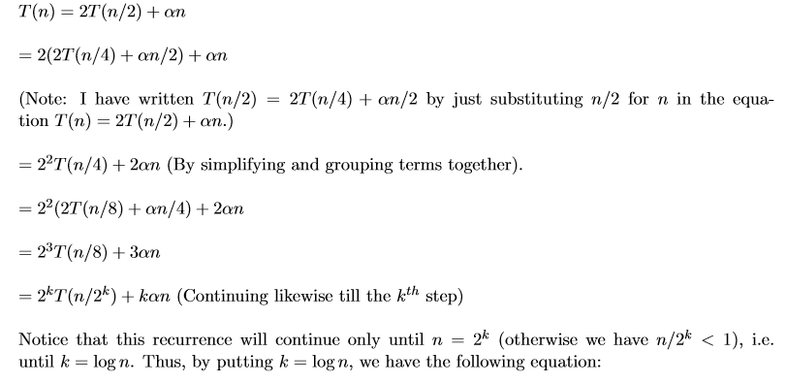
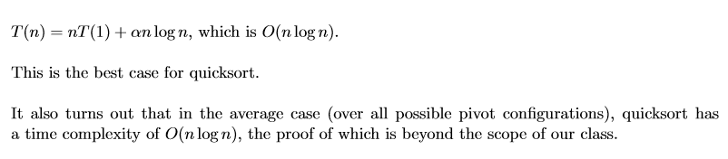

Slide 62
Quicksort Analysis
Assume that keys are random, uniformly distributed.
Best case running time: O(n log₂n)

Slide 63
Quicksort Analysis
Assume that keys are random, uniformly distributed.
Best case running time: O(n log₂n)
Worst case running time?

Slide 64
Quicksort: Worst Case
Which happens when the pivot we picked turns out to be the least element of the array to be sorted, in every step (i.e. in every recursive call).
A similar situation will also occur if the pivot happens to be the largest element of the array to be sorted.

Slide 65
Quicksort: Worst Case
Assume first element is chosen as pivot.
Assume we get array that is already in order:
pivot_index = 0
2
4
10
12
13
50
57
63
100
[0] [1] [2] [3] [4] [5] [6] [7] [8]
too_big_index
too_small_index

Slide 66
While data[too_big_index] <= data[pivot]
++too_big_index
While data[too_small_index] > data[pivot]
--too_small_index
If too_big_index < too_small_index
swap data[too_big_index] and data[too_small_index]
While too_small_index > too_big_index, go to 1.
Swap data[too_small_index] and data[pivot_index]
pivot_index = 0
2
4
10
12
13
50
57
63
100
[0] [1] [2] [3] [4] [5] [6] [7] [8]
too_big_index
too_small_index

Slide 67
While data[too_big_index] <= data[pivot]
++too_big_index
While data[too_small_index] > data[pivot]
--too_small_index
If too_big_index < too_small_index
swap data[too_big_index] and data[too_small_index]
While too_small_index > too_big_index, go to 1.
Swap data[too_small_index] and data[pivot_index]
pivot_index = 0
2
4
10
12
13
50
57
63
100
[0] [1] [2] [3] [4] [5] [6] [7] [8]
too_big_index
too_small_index

Slide 68
While data[too_big_index] <= data[pivot]
++too_big_index
While data[too_small_index] > data[pivot]
--too_small_index
If too_big_index < too_small_index
swap data[too_big_index] and data[too_small_index]
While too_small_index > too_big_index, go to 1.
Swap data[too_small_index] and data[pivot_index]
pivot_index = 0
2
4
10
12
13
50
57
63
100
[0] [1] [2] [3] [4] [5] [6] [7] [8]
too_big_index
too_small_index

Slide 69
While data[too_big_index] <= data[pivot]
++too_big_index
While data[too_small_index] > data[pivot]
--too_small_index
If too_big_index < too_small_index
swap data[too_big_index] and data[too_small_index]
While too_small_index > too_big_index, go to 1.
Swap data[too_small_index] and data[pivot_index]
pivot_index = 0
2
4
10
12
13
50
57
63
100
[0] [1] [2] [3] [4] [5] [6] [7] [8]
too_big_index
too_small_index

Slide 70
While data[too_big_index] <= data[pivot]
++too_big_index
While data[too_small_index] > data[pivot]
--too_small_index
If too_big_index < too_small_index
swap data[too_big_index] and data[too_small_index]
While too_small_index > too_big_index, go to 1.
Swap data[too_small_index] and data[pivot_index]
pivot_index = 0
2
4
10
12
13
50
57
63
100
[0] [1] [2] [3] [4] [5] [6] [7] [8]
too_big_index
too_small_index

Slide 71
While data[too_big_index] <= data[pivot]
++too_big_index
While data[too_small_index] > data[pivot]
--too_small_index
If too_big_index < too_small_index
swap data[too_big_index] and data[too_small_index]
While too_small_index > too_big_index, go to 1.
Swap data[too_small_index] and data[pivot_index]
pivot_index = 0
2
4
10
12
13
50
57
63
100
[0] [1] [2] [3] [4] [5] [6] [7] [8]
too_big_index
too_small_index

Slide 72
While data[too_big_index] <= data[pivot]
++too_big_index
While data[too_small_index] > data[pivot]
--too_small_index
If too_big_index < too_small_index
swap data[too_big_index] and data[too_small_index]
While too_small_index > too_big_index, go to 1.
Swap data[too_small_index] and data[pivot_index]
pivot_index = 0
2
4
10
12
13
50
57
63
100
[0] [1] [2] [3] [4] [5] [6] [7] [8]
<= data[pivot]
> data[pivot]

Slide 73
Quicksort Analysis
Assume that keys are random, uniformly distributed.
Best case running time: O(n log₂n)
Worst case running time?
Recursion:
Partition splits array in two sub-arrays:
one sub-array of size 0
the other sub-array of size n-1
Quicksort each sub-array
Depth of recursion tree?

Slide 74
Quicksort Analysis
Assume that keys are random, uniformly distributed.
Best case running time: O(n log₂n)
Worst case running time?
Recursion:
Partition splits array in two sub-arrays:
one sub-array of size 0
the other sub-array of size n-1
Quicksort each sub-array
Depth of recursion tree? O(n)

Slide 75
Quicksort Analysis
Assume that keys are random, uniformly distributed.
Best case running time: O(n log₂n)
Worst case running time?
Recursion:
Partition splits array in two sub-arrays:
one sub-array of size 0
the other sub-array of size n-1
Quicksort each sub-array
Depth of recursion tree? O(n)
Number of accesses per partition?

Slide 76
Quicksort Analysis
Assume that keys are random, uniformly distributed.
Best case running time: O(n log₂n)
Worst case running time?
Recursion:
Partition splits array in two sub-arrays:
one sub-array of size 0
the other sub-array of size n-1
Quicksort each sub-array
Depth of recursion tree? O(n)
Number of accesses per partition? O(n)

Slide 77
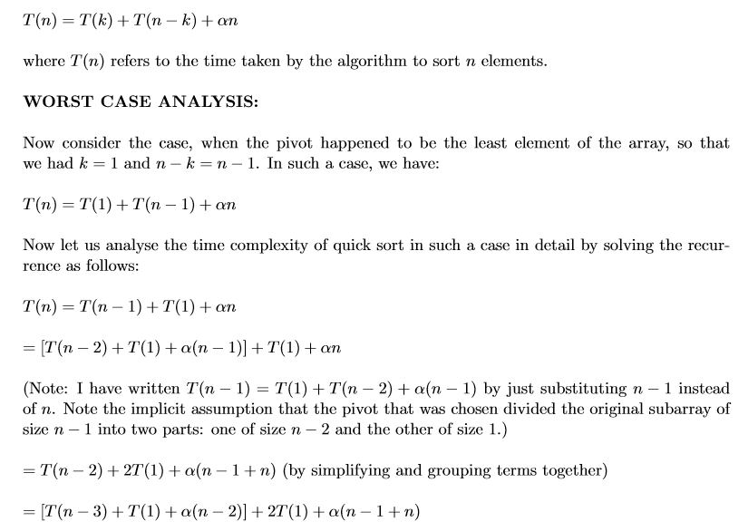

Slide 78
Quicksort Analysis
Assume that keys are random, uniformly distributed.
Best case running time: O(n log₂n)
Worst case running time: O(n²)!!!

Slide 79
Quicksort Analysis
Assume that keys are random, uniformly distributed.
Best case running time: O(n log₂n)
Worst case running time: O(n²)!!!
What can we do to avoid worst case?

Slide 80
Improved Pivot Selection
Pick median value of three elements from data array:
data[0], data[n/2], and data[n-1].
Use this median value as pivot.

Slide 81
Improving Performance of Quicksort
Improved selection of pivot.
For sub-arrays of size 3 or less, apply brute force search:
Sub-array of size 1: trivial
Sub-array of size 2:
if(data[first] > data[second]) swap them
Sub-array of size 3: left as an exercise.

